Slide 1
Linear Algebra
Marziyeh Mousavi
Introduction to datascience
Fall 2024

Slide 2
Content
Vector
Matrices

Slide 3
Vectors
Abstractly, vectors are objects that can be added together to form new vectors and that can be multiplied by scalars (i.e., numbers), also to form new vectors.
Concretely (for us), vectors are points in some finite-dimensional space.
Although you might not think of your data as vectors, they are often a useful way to represent numeric data.

Slide 4
Example
if you have the heights, weights, and ages of a large number of people, you can treat your data as three-dimensional vectors [height, weight, age].
If you’re teaching a class with four exams, you can treat student grades as four-dimensional vectors [exam1, exam2, exam3, exam4].

Slide 5

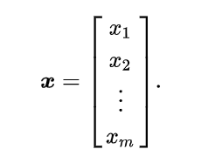
Types of Vector Representation:
Row Vector:
A row vector has one row and n columns.
Column Vector:
A column vector has one column and n rows.

Slide 6
Vector’s arithmetic
Addition
Multiplication
Distance
Magnitude

Slide 7
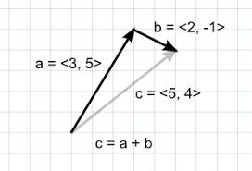
Addition
Here we can see how we add to vectors:

Slide 8
Multiplication
There are two type of multiplication we can perform on vectors, Dot Product and Cross Product, For Data Science related study Cross Product is not used frequently so we will focus on Dot Product.

Slide 9
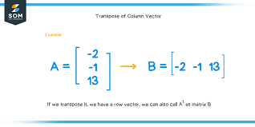
Multiplication-Transpose
Transpose:
Before performing the dot product on two vectors perform transpose operation on one of the vector if both the vectors are of same representation e.g. both the vectors are row vectors. Transpose of a vector converts the row vector to column vector and column vector to row vector.

Slide 10
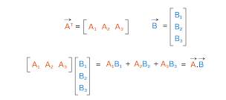
Multiplication-Dot product
We represent the dot product of two vectors by putting a dot between the vectors e.g. (A . B).
Note: For performing the dot product between two vectors number of column in vector 1 and number of row in vector 2 should be same. Which means dimension of both the vectors should be same. Before performing the dot product perform the transpose operation on one of the vector iff both the vectors are of same representation e.g. both the vectors are row vectors.

Slide 11

Distance
The distance between vectors V and W is calculated like below:

Slide 12
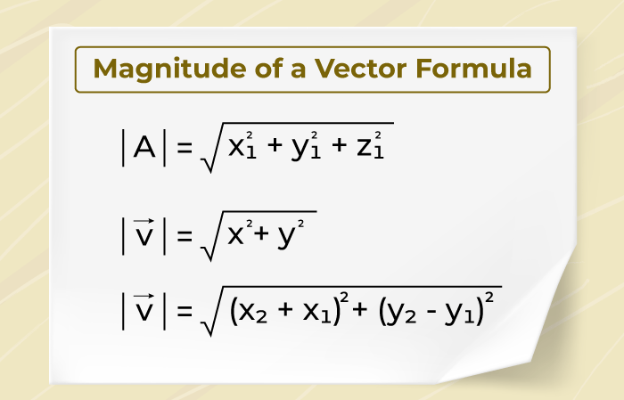
Magnitude
The magnitude of a vector is its length or size. It's the distance between the vector's initial and end points, and is represented by the symbol |A|
The magnitude of a vector can be calculated using the distance formula, or by taking the square root of the sum of the squares of the vector's components:

Slide 13
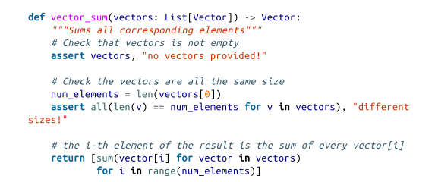
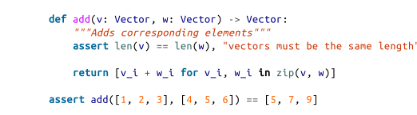
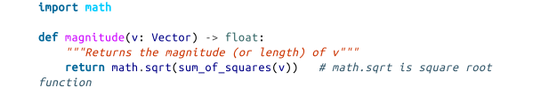


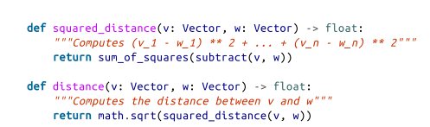

Some python functions for vectors
Note that we usually use numpy instead of pure python but coding from scratch helps you to understand better.

Slide 14
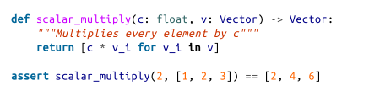



Some python functions for vectors

Slide 15
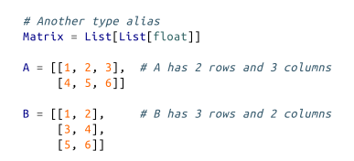
Matrices
A matrix is a two-dimensional collection of numbers. We will represent matrices as lists of lists, with each inner list having the same size and representing a row of the matrix. If A is a matrix, then A[i][j] is the element in the ith row and the jth column. Per mathematical convention,
we will frequently use capital letters to represent matrices

Slide 16
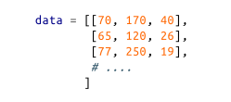
Importance of Matrices
Matrices will be important to us for several reasons.
First, we can use a matrix to represent a dataset consisting of multiple vectors, simply by considering each vector as a row of the matrix. For example, if you had the heights, weights, and ages of 1,000 people, you could put them in a 1,000 × 3 matrix:

Slide 17
Importance of Matrices
Second, as we’ll see later, we can use an n × k matrix to represent a linear function that maps k-dimensional vectors to n-dimensional vectors. Several of our techniques and concepts will involve such functions

Slide 18
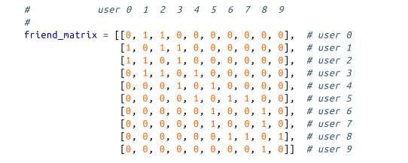

Importance of Matrices
Third, matrices can be used to represent binary relationships. In Chapter 1, we represented the edges of a network as a collection of pairs (i, j). An alternative representation would be to create a matrix A such that A[i][j] is 1 if nodes i and j are connected and 0 otherwise.
A

Slide 19
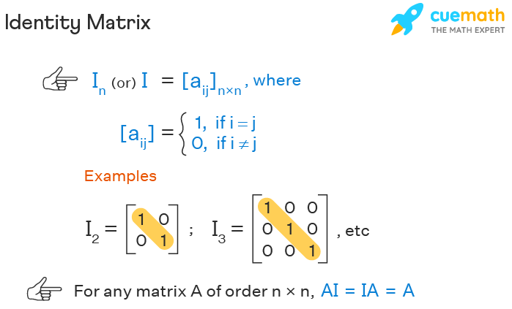
Identity Matrix
An identity matrix is a square matrix in which all the elements of principal diagonals are one, and all other elements are zeros. It is denoted by the notation “In” or simply “I”.

Slide 20
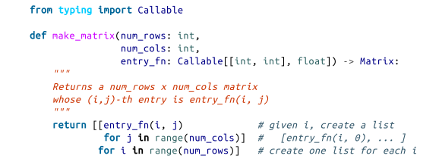

Some python functions for matrices

Slide 21
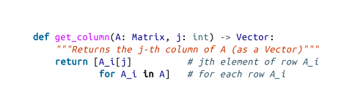
Some python functions for matrices

Slide 22
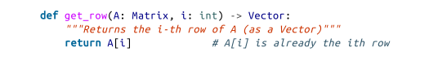
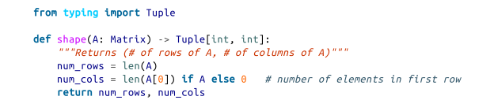
Some python functions for matrices

